Slide 1

KNOWLEDGE AND CURRICULUM
Unit II - Social bases of Education
Dr.V.Regina
Principal ,Asst,Professor of Biological Science
CSI Bishop Newbigin College of Education
No.109, Dr.Radhakrishnan salai, Mylapore, Chennai - 600004

Slide 2
Synopsis
Introduction
Influence of society on education
Influence of culture on education
Influence of modernity on education
Influence of industrialisation and democracy
Influence of individual autonomy and reason on education
Understanding education in relation to Contemporary values : Equity.Equality.Individual opportunity
Understanding social justice and dignity
Social justice and dignity with reference to Dr.B.R.Ambedkar
Conclusion
Dr. V. Regina , Principal CSI BISHOP NEWBIGIN COLLEGE OF EDUCATION

Slide 3
Learning Objectives
To discuss the influences of society, culture, modernity, industrialisation, individual autonomy and reason
To understand education in relation to contemporary values
To distinguish between equity and equality
Learning Outcomes
Demonstrate knowledge of the concepts of the society
Foster logical reasoning
Interpret, compare and contrast - equity, equality, individual opportunity, social justice and dignity
Dr. V. Regina , Principal CSI BISHOP NEWBIGIN COLLEGE OF EDUCATION

Slide 4
Introduction
The needs of different societies differ therefore education should be dynamic in nature.
An interaction between the individual and the society.
The school is a Social institution which purifies the society.
Social basis of Education
Every society with its own changing Socio-Cultural needs will require an education to meet those needs. Since needs change continuously, the way of education must also change
Dr. V. Regina , Principal CSI BISHOP NEWBIGIN COLLEGE OF EDUCATION

Slide 5
Preservation and transmission of our social, moral and cultural value.
Awakening of social feelings.
Political development of society
Economic development of society
Social control
Social changes and reforms
Socialization of a child
Education leads to economic prosperity
Gives people the knowledge they need to vote
Promotes tolerance
Has power to help society
Reduced violence, creates hope for the future
Influence of society on Education
The function of education is multidimensional within the school systems. At outside , it may be viewed as a self contained social systems with a unique organisation and unique patterns.
Dr. V. Regina , Principal CSI BISHOP NEWBIGIN COLLEGE OF EDUCATION
Dr. V. Regina , Principal CSI BISHOP NEWBIGIN COLLEGE OF EDUCATION

Slide 6
Influence of culture on Education
Preservation of culture
Culture is the content of education. Education transmits culture through formal and informal curriculum. The values that the institution transmits can be seen as the culture of the society.
Transmission
of culture
Development
of culture
Influence of culture on Education
Teaching languages for education - a tool for communication
Knowledge and skills in material culture are taught in agriculture, natural sciences etc
Aesthetic values - art and music
Religious studies - spiritual and moral education
Regulation, maintenance and continued survival of the society - social control
Development
of personality
Continuity of culture
Removing
cultural lag
Dr. V. Regina , Principal CSI BISHOP NEWBIGIN COLLEGE OF EDUCATION

Slide 7
Influence of Modernity on Education
The process of transforming a backward thinking society towards forward looking one. Modernisation helps a nation to establish its own identity.increase social mobility and impersonal social interactions.
Education role in the transformation of traditional society.
Thinking of people in new perspective
It shapes the life of every individual
Helps a lot in adopting contemporary needs.
Diffusion of innovation made the society modern
Industrialisation
Urbanization
Secularization
Influence of Modernity on Education
Social classes
Social changes
Westernisation
Democratization
Dr. V. Regina , Principal CSI BISHOP NEWBIGIN COLLEGE OF EDUCATION

Slide 8
Physical health of children
Universal and compulsory education
Intelligent test
Co-operation between all agencies of education
Equal opportunities
Influence of Industrialisation & Democracy on Education
Free
education
Adult
education
School
Industrialisation through technological improvement, increases income.
By increasing productivity and generating wealth, industrialisation encourages the transition to democracy.
Respect of teachers’ personality
Child centered
education
Methods of
teaching
Student unions
School
administration
Importance of individual attention
Social activities
Dr. V. Regina , Principal CSI BISHOP NEWBIGIN COLLEGE OF EDUCATION

Slide 9
Influence of individual Autonomy and Reason on Education
Basic moral and political value
In social structures
Individual autonomy is a distinctively human value that is required for human well-being.
Autonomy of human beings depends on their ability to behave according to laws that are given to them by the proper exercise of reason.
Reason is the capacity for consciously making sense of things applying logic, establishing and verifying facts and chanchinh or justifying practices , institutions and beliefs on new or existing information.
Local governance autonomy
School autonomy
Teachers autonomy
Influence of individual Autonomy and Reason on Education
Parent Autonomy
Student autonomy
Dr. V. Regina , Principal CSI BISHOP NEWBIGIN COLLEGE OF EDUCATION

Slide 10
Understanding education in relation to modern values : Equity, Equality and Individual Opportunity.
Study of excellence and equity
Fairness and inclusions are two factors
An academic system that practices educational equity is a strong foundation of a society that is fair and thrilling.
Equity in Education
Society has a moral obligation to make sure that all children receive an adequate education
All students have talents that grow through formal learning
Equality in Education
Education has become the main provider of individual opportunity in our society
Individual opportunity
Dr. V. Regina , Principal CSI BISHOP NEWBIGIN COLLEGE OF EDUCATION

Slide 11
Social Justice
“Respect , Relationships, Reconciliation”
Is concerned with a achieving equitable and quality education for all student.
Knowledge helps students better tackle real - world problems
Dignity
Right to education is considered a basic human right. A good teacher shows his affection and love to his pupils and affects children in almost every way like manners, styles and actions. This indicates how a teacher becomes a role model to his pupils. Thus a teacher should maintain stature and behaviour that upholds dignity-good moral and professional etiquette.
Understanding education in relation to Social Justice and dignity with reference to Dr. B R Ambedkar
Dr. V. Regina , Principal CSI BISHOP NEWBIGIN COLLEGE OF EDUCATION

Slide 12
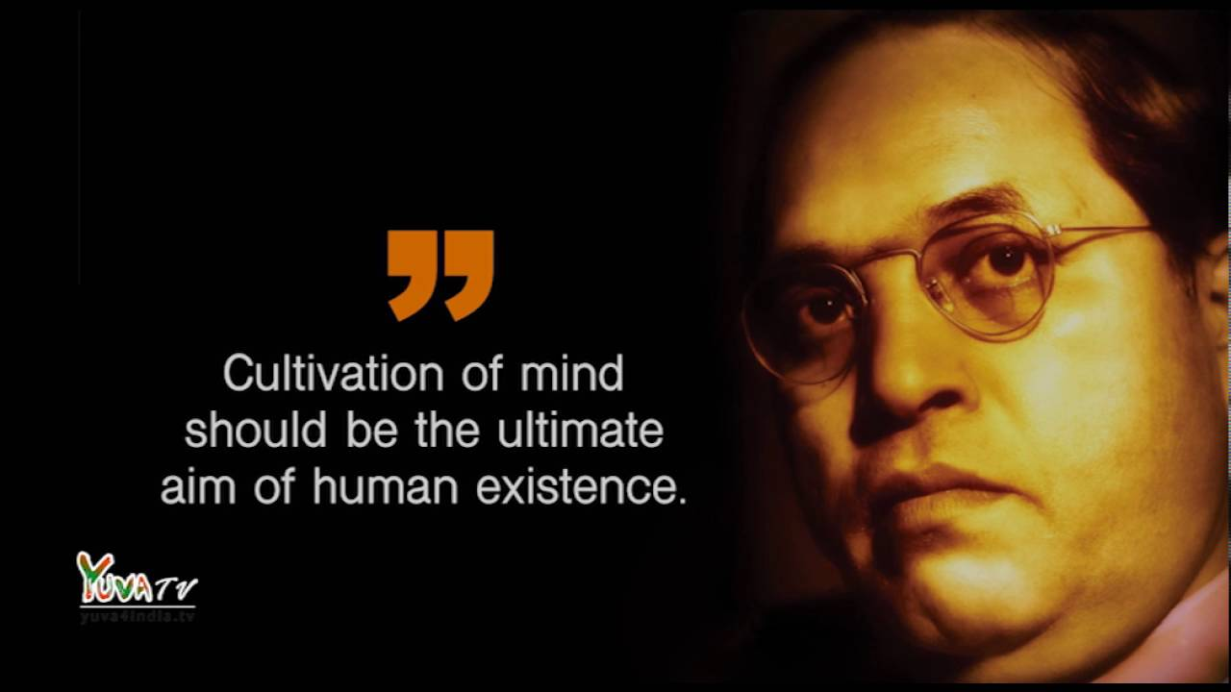
Dr. B R Ambedkar
Social Justice
Is a concept of fair and just relation between the individual and society.
Social justice maintains that all people deserve and should have access to same rights and resources
Social rights looks for equality in and out of the court systems.
Social Dignity
The unwillingness on the part of the other to appreciate Ambedkar’s efforts to combine equalitt with merit is also evident in his experience with a most modern personality
He said, “ I like the religion that teaches liberty, equality and fraternity”.
He was proud of Article 32 - fundamental rights
Dr. V. Regina , Principal CSI BISHOP NEWBIGIN COLLEGE OF EDUCATION

Slide 13
Constitutional provisions available for justice, equality and fraternity.
Right to equality
Right to freedom
Right against exploitation
Right to freedom of religion
Cultural and educational rights
Right to constitutional remedies
Dr. B R Ambedkar
Social justice denotes the equal treatment of all citizens without any social distinction based on caste, colors, race, religion, sex and so on.
Social injustice holds the aims of equal opportunity to every citizen in the matter of social and economical activities and to prevent inequalities.
Dr. V. Regina , Principal CSI BISHOP NEWBIGIN COLLEGE OF EDUCATION

Slide 14
Dr. B R Ambedkar
“I measure the progress of a community by the degree of progress which women have achieved”
Education is an instrument to liberate people
Fight against all forms of injustice
Education which will enlighten the downtrodden
Educate… Agitate… and Organize… Educate
Education generates conscience among depressed classes. Ambedkar stands for the rights of women- Right to education.
Dr. V. Regina , Principal CSI BISHOP NEWBIGIN COLLEGE OF EDUCATION

Slide 15
The word “agitate” does not mean that to agitate physically; It is a mental revolution in its place.
It does not mean to go out and start protesting violently on the streets.
Educated people to form organizations
Agitate
Dr. V. Regina , Principal CSI BISHOP NEWBIGIN COLLEGE OF EDUCATION

Slide 16
Unite and struggle for the common goal as one force
Collectively organize
Ambedkar’s this philosophy giving idea of education and equal opportunity to the people aims at removing the barriers in indian hindu religious caste system and development of backward caste as well as all marginalised communities.
Organize
Dr. V. Regina , Principal CSI BISHOP NEWBIGIN COLLEGE OF EDUCATION

Slide 17
Education takes place in society
Education is essentially a social process
Social environment educate the child
Education is a lifelong process
Education has special role to play for social reform
Conclusion
Dr. V. Regina , Principal CSI BISHOP NEWBIGIN COLLEGE OF EDUCATION

Slide 18

Suggestive Readings
Bennett, C.(1995). Comprehensive multicultural education; Theory and practice (3rd ed.) Massachusetts; Allen & Bacon
Putnam, R. (2004). Education, diversity, Social Cohesion and Social Capital; Note for discussion presented at Meeting OECD Education Ministers, Dublin, March 2004
http://educationnorthwest/org/equity-program/educational.
Dr. V. Regina , Principal CSI BISHOP NEWBIGIN COLLEGE OF EDUCATION

